Slide 1

Computer Programming for Engineers
Week 14 Lecture 2
Dec. 1, 2022
Lecturer: Dr. Mohammad Mahdi Javidan
College of Engineering, Sungkyunkwan University
Fall Semester 2022

Slide 2
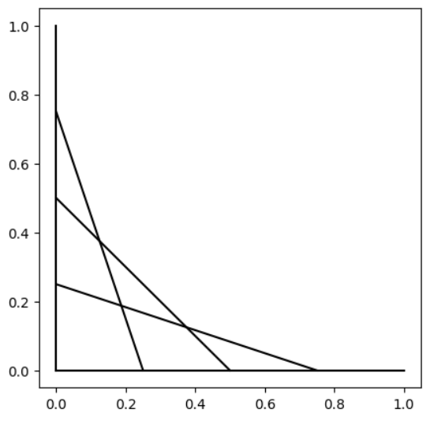
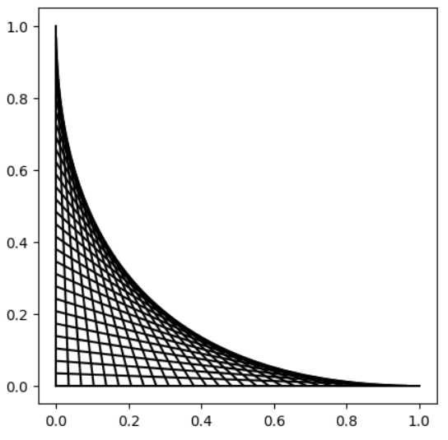


Problem 11
Program a function draw(n) which divides the x- and y-axis from 0 to 1 into n points and draw n lines between the points on these two axis as depicted below.
Test case
$$n=5$$
$$n=30$$
College of Engineering, Sungkyunkwan University

Slide 3
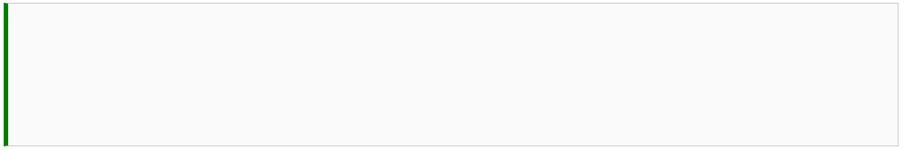
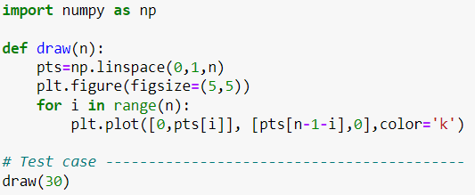
Problem 11
College of Engineering, Sungkyunkwan University

Slide 4

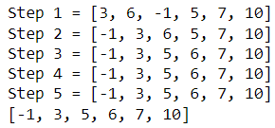
Problem 12
Insertion sort is a simple sorting algorithm, which iteratively places each unsorted element at its suitable place. At each iteration it start with a key element and it compares it with the previous elements till it is at the right place.
Test case
College of Engineering, Sungkyunkwan University

Slide 5
Problem 12
Step 1
Step 3
6 | 3 | -1 | 5 | 7 | 10
-1 | 3 | 6 | 5 | 7 | 10
6 | 6 | -1 | 5 | 7 | 10
-1 | 3 | 6 | 6 | 7 | 10
3 | 6 | -1 | 5 | 7 | 10
-1 | 3 | 5 | 6 | 7 | 10
Step 2
Step 4
3 | 6 | -1 | 5 | 7 | 10
-1 | 3 | 5 | 6 | 7 | 10
3 | 6 | 6 | 5 | 7 | 10
Step 5
3 | 3 | 6 | 5 | 7 | 10
-1 | 3 | 5 | 6 | 7 | 10
-1 | 3 | 6 | 5 | 7 | 10
College of Engineering, Sungkyunkwan University

Slide 6
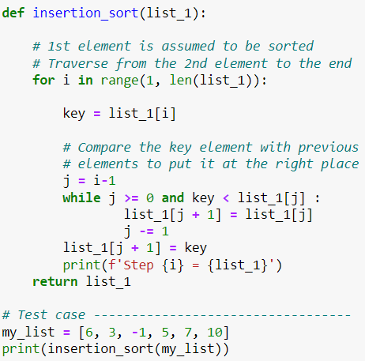
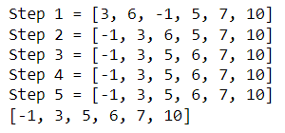
Problem 12
College of Engineering, Sungkyunkwan University

Slide 7


Problem 13
Write a function climb_stairs(n) which gives the number of ways to climb n stairs to the top.
Test case:
College of Engineering, Sungkyunkwan University

Slide 8
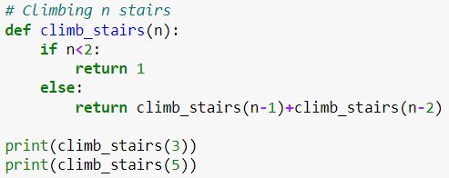
Problem 13
College of Engineering, Sungkyunkwan University

